Slide 1
Recent
Technical Assist
Topics

Slide 2
Topic 1: Cycles of the ESFR Program
This describes the program as it currently configured.
A full ESFR cycle runs for 3 years
All 100 counties are served over a 3 year period: 34/33/33
Counties may apply only in their year of eligibility to apply
A full cycle will begin in 2025
Notice of Funding Availability (NOFA) posted in Nov/Dec of the preceding year
Major Changes usually occur at the beginning of a cycle
The 3 yr. Funding Cycle is in place to provide Local Governments and Non-profits a continuous flow of funding

Slide 3
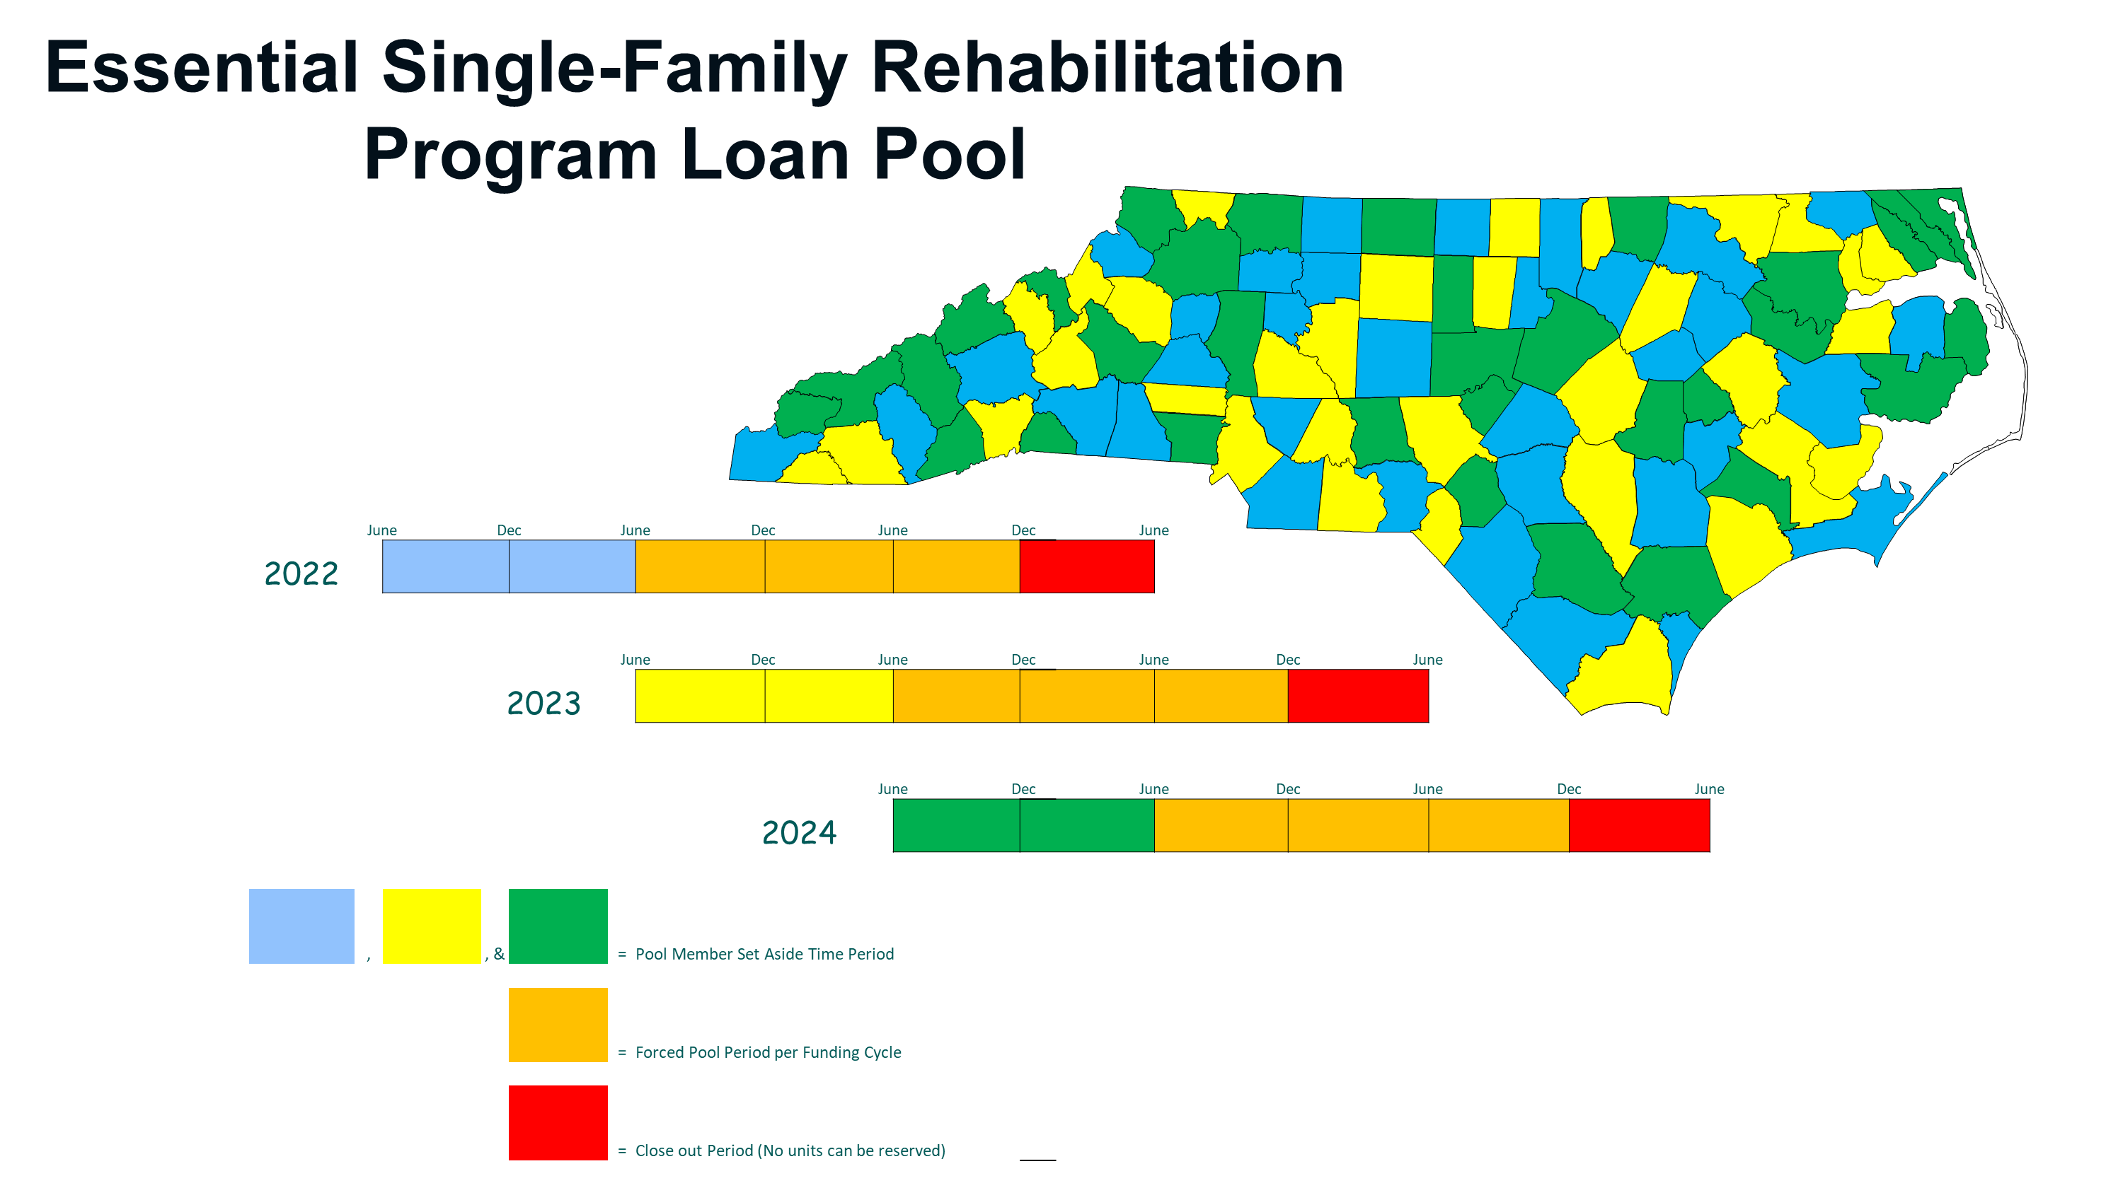
Topic 1: Cycles of the ESFR Program

Slide 4
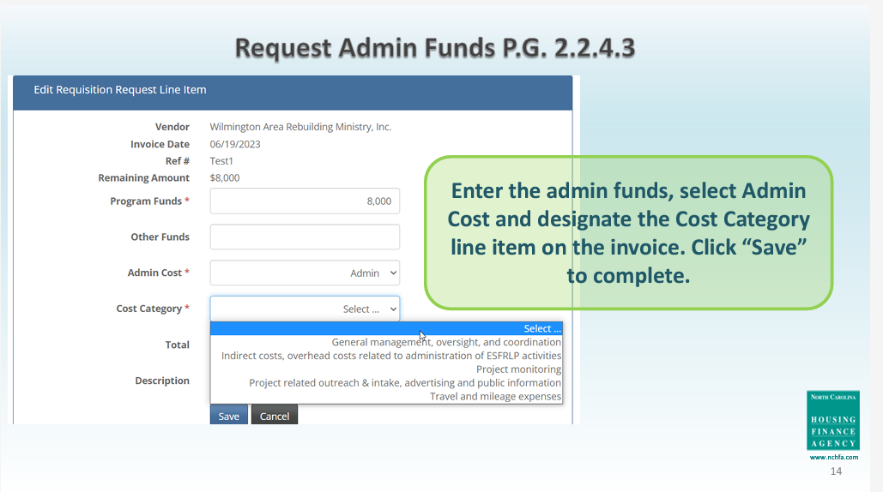
Topic 2: Administrative Funds Backup documentation
Once Administrative Funds are available, per PG 2.2.4.3:
Admin invoices should be approved by the Member’s own internal Accounting processes to meet 2 CFR 200
Approved Admin Invoices should be uploaded to the Partner Portal
If there is an outside vendor invoice, this is the best choice to upload
If Admin charges are internal, create an invoice on Company letterhead.
Keep backup documentation for internal charges such as payroll, timesheets, allocation plans, etc.

Slide 5
Topic 3: Assisting ESFR Clients targeted by a scam
Potential Signs of a Scam
Homeowner receives a letter after the loan/project is closed.
As our subrecipient, your organization should deliver the bulk of information.
The homeowner (borrower) is being directed online to a location online that is not NCHFA.com
The homeowner is being asked to:
  purchase something, like insurance.
  Give out information
Links/Emails to NCHFA websites:
  https://www.nchfa.com/homeowners/manage-your-loan
  subordinations@nchfa.com (email)
  payoffs@nchfa.com (email)
  occupancy@nchfa.com (email for estate and occupancy issues)

Slide 6
Topic 3: Assisting ESFR Clients targeted by a scam
Typical Letters NCHFA sends
NCHFA letters (with two exceptions) are for information only:
  Good Faith Estimate
  Estoppel
  Welcome letter with first Annual Privacy from NCHFA servicing
  Annual Privacy notice from NCHFA servicing
  Satisfaction of the Loan/Release of the Lien-Borrower to get copy from Register of Deeds
These two types of letters require a response:
  Estate Letters if the Borrower dies
  Borrower changing occupancy letter
Website discussing solicitations:
https://www.nchfa.com/homeowners/manage-your-loan/notice-borrowers-regarding-insurance-solicitations

Slide 7
Topic 4: Project Amendments (PA)
AKA: Why we need a PA when you add team personnel
Why do I need to file a Project Amendment for anyone with access to the Portal?
  The portal collects PII (personally-identifiable information) data, much of this information is considered sensitive
  There are no firewalls inside the portal, all data can be seen by those with access
  HUD requires that the Agency manages access to sensitive PII
  Therefore, the Agency needs a PA on every person who has access to the Portal

Slide 8
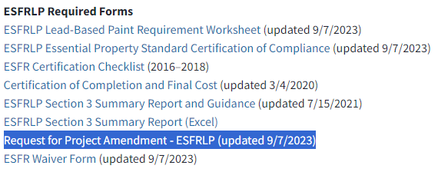
Topic 4: Project Amendments (PA)
Where to Find a PA
Website: https://www.housingbuildsnc.com/home-ownership-partners/community-partners/community-programs/essential-single-family-rehabilitation-loan-pool/forms-and-resources
What information does a Project Amendment Collect?
Who and what position is being replaced
Who is the new person?
  Position(s) being replaced
  Name
  Title
  Email
  Phone number

Slide 9
Topic 5: Identifying Lead Based Paint (LBP) professionals
How to determine the professional you need for ESFR
ESFR projects have two governing Authorities when considering lead:
  EPA
  HUD
EPA has designated the Department of Health and Human Services (DHHS) as the party responsible for administering EPA LBP regulations in NC. Therefore:
  The Health Hazards Control Unit (HHCU) of DHHS administers LBP in NC, not the EPA
  Credentials are issued by DHHS-HHCU to the following:
    Renovation: Certified RRP Firms and Certified RRP Renovators
      RRP= Renovation and Repair Program
    Abatement: Lead Abatement Firms and Lead Abatement Certified Individuals
    Both Abatement and Renovation: must carry both sets of credentials

Slide 10
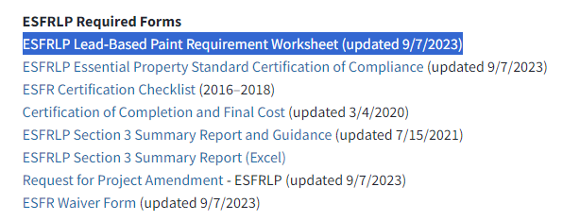
Topic 5: Identifying LBP professionals
AKA: Searching online for LBP professionals
Step 1: Fill out the LBP Worksheet available at this website: https://www.housingbuildsnc.com/home-ownership-partners/community-partners/community-programs/essential-single-family-rehabilitation-loan-pool/forms-and-resources

Slide 11
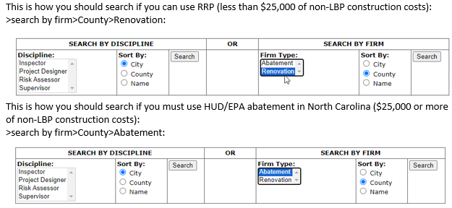
Topic 5: Identifying LBP professionals
AKA: Searching online for LBP professionals
Step 2: Look for LBP professionals at this
Website: https://schs.dph.ncdhhs.gov/lead/accredited.cfm

Slide 12
Topic 6: RRP Firm and RRP Renovator – What’s the Diff?
Certified Firm
  Must be renewed annually by an eligible contractor or other entity
  Submit an application downloaded from the website, Cost is $300/year
  Responsible for record keeping, all units serviced that were built prior to 1978
Certified Renovator
  Must be renewed by taking an update class every 5 years
  No annual maintenance cost
  Request to be attached to a Certified Firm
  Responsible for oversite in the field and teaching non-certified individuals, must be onsite during project to oversee work
EVERY ESFR project must have RRP professionals on site

Slide 13
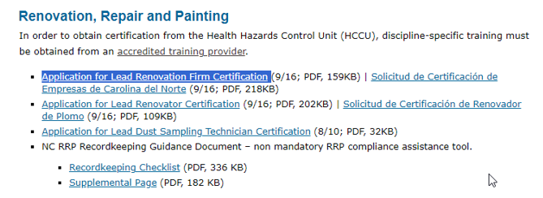
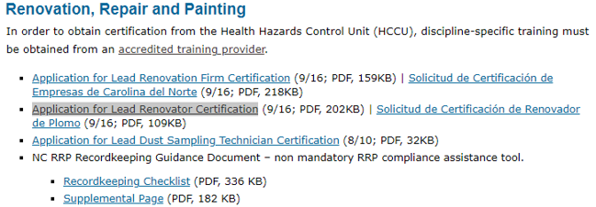
Topic 6: RRP Firm and RRP Renovator – How to Apply
Website: https://schs.dph.ncdhhs.gov/lead/accredited.cfm
Step 1: Download and complete the form below “Application for Lead Renovation Firm Certification”:
Step 2: Download and complete the form below “Application for Lead Renovator Certification”:
Step 3: Attach required documents & a $300 check
Step 4: Create a self-addressed stamped envelope for return of your RRP Firm Certificate and RRP Lead Renovator Letter
Step 5: Bundle and send together

Slide 14
Topic 7: Eligibility of non-EPS items
Yes, this type of expenditure is eligible if you can answer all of the following statements in the affirmative:
The home meets all items in the Essential Property Standard and any noted deficiencies are complete and executed and all required systems will last 5 years or longer.
You would treat every other home/homeowner the same if funds allowed.
In this home with this homeowner, no other need appears more pressing as a threat to life and safety of the occupant(s).
There are sufficient funds in the project.
The construction item will improve at least one of the following areas of the home: accessibility, safety, health, durability/longevity, or energy.
If you feel that you can answer all of the above in the affirmative just document everything as required and move forward.

Slide 15
Topic 7: Eligibility of non-EPS items
Yes, this type of expenditure is eligible if you can answer all of the following statements in the affirmative:
The home meets all items in the Essential Property Standard and any noted deficiencies are complete and executed and all required systems will last 5 years or longer.
You would treat every other home/homeowner the same if funds allowed.
In this home with this homeowner, no other need appears more pressing as a threat to life and safety of the occupant(s).
There are sufficient funds in the project.
The construction item will improve at least one of the following areas of the home: accessibility, safety, health, durability/longevity, or energy.
If you feel that you can answer all of the above in the affirmative just document everything as required and move forward.

Slide 16
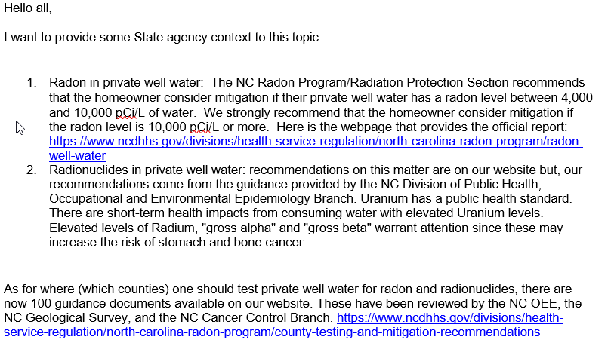
Topic 8: Testing for Radon in Water – When & Why
From DHHS, NC Radon Program Coordinator

Slide 17
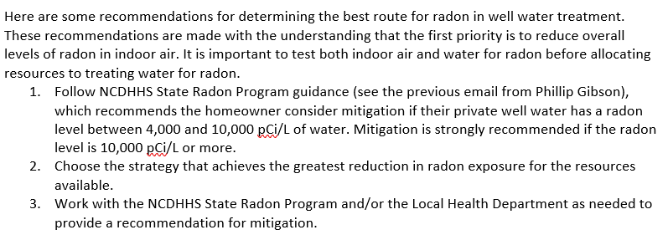
Topic 8: Testing for Radon in Water – Steps
From Wake County Environmental Services - FIRST PRIORITY is to reduce radon in indoor air

Slide 18
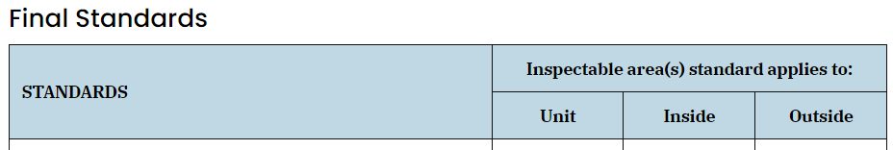
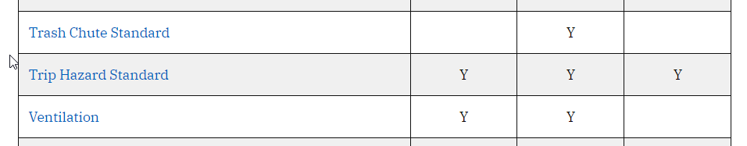
Topic 9: Tripping Hazards per HUD’s NSPIRE
https://nspire.us-hc.com/1/en/topic/tripping-hazards
NSPIRE is the new HUD National Standards for the Physical Inspection of Real Estate

Slide 19
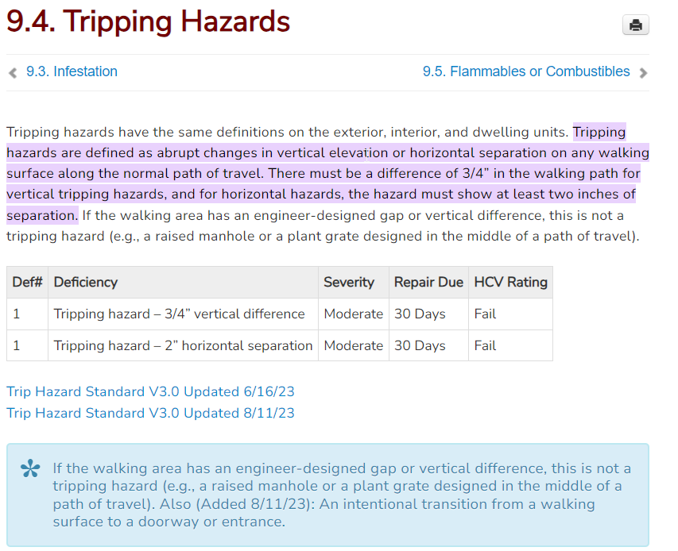
Topic 9: Tripping Hazards per HUD’s NSPIRE

